Slide 1

Supercities
A snap-shot of urban development

Slide 2

Definition:
A megacity has two quantitative characteristics:
More than 2,000 people per square mile
More than 1,000,000 people within city limits

Slide 3




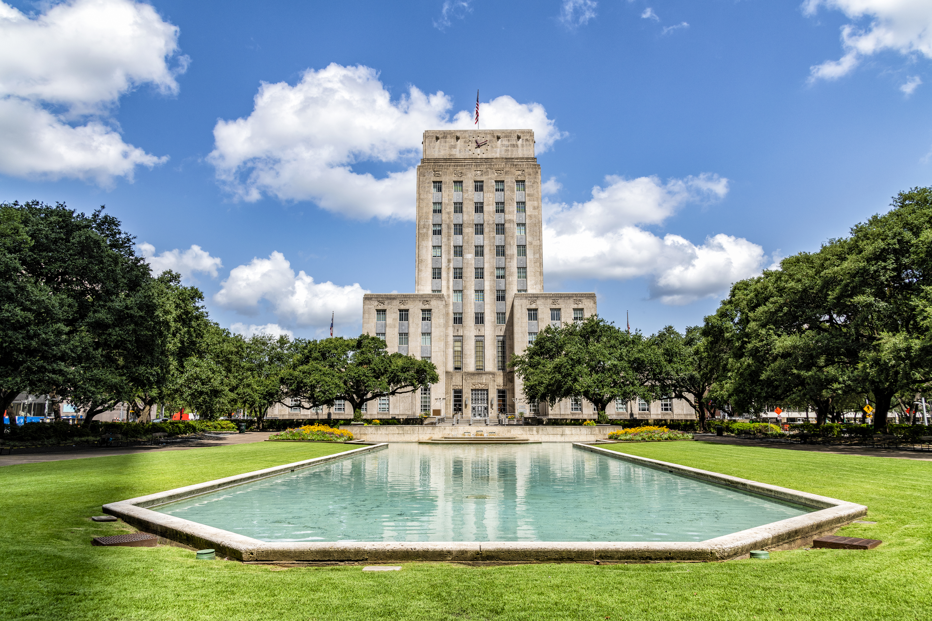

Our cities: the top 5
1
2
3
New York
Los Angeles
Chicago
4
5
Houston
Phoenix

Slide 4

Measures
Economic
Median Household Income, Unemployment Rate, Poverty
Demographic
Population Density, Median Age, Education Level
Housing
Rental Price (Median Rent),
Quality of Life
Air Quality Index, Commute time, Walkability Score, Health Behaviors & Outcomes

Slide 5
Research Questions
Which cities have higher population density?
If a city is larger, will there be higher household income and higher unemployment rate?
If a city is larger, will it have a higher median age and education level?
How does city size relate to poverty rates and median rent?

Slide 6

Data Visualization

Slide 7
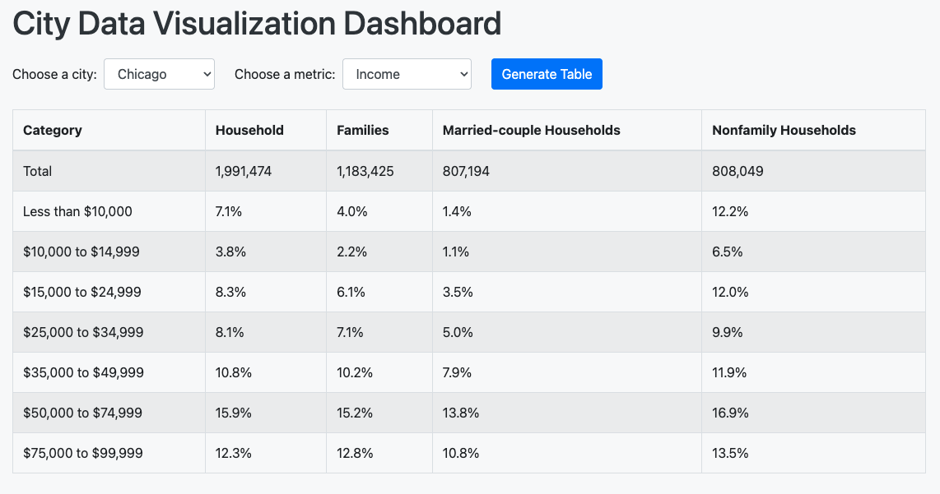
Interactive Data Visualization Dashboard

Slide 8
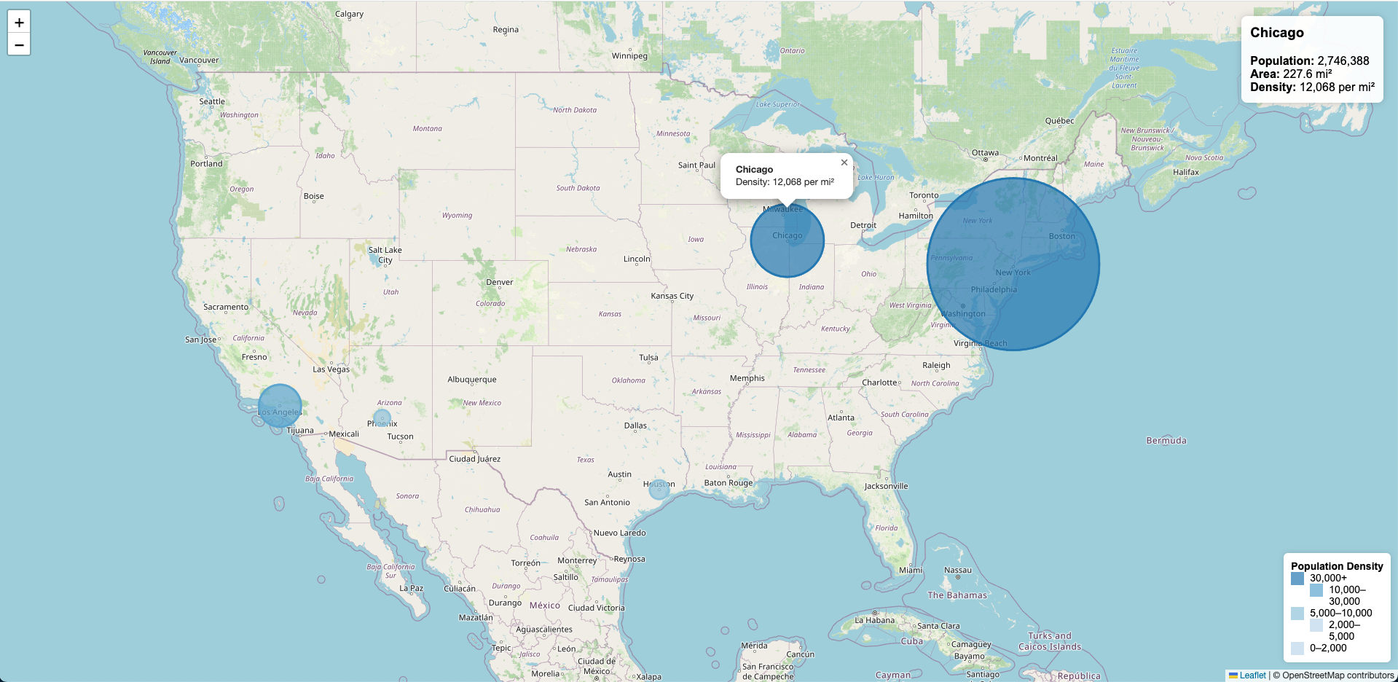
Visualization #1 – interactive population density map

Slide 9
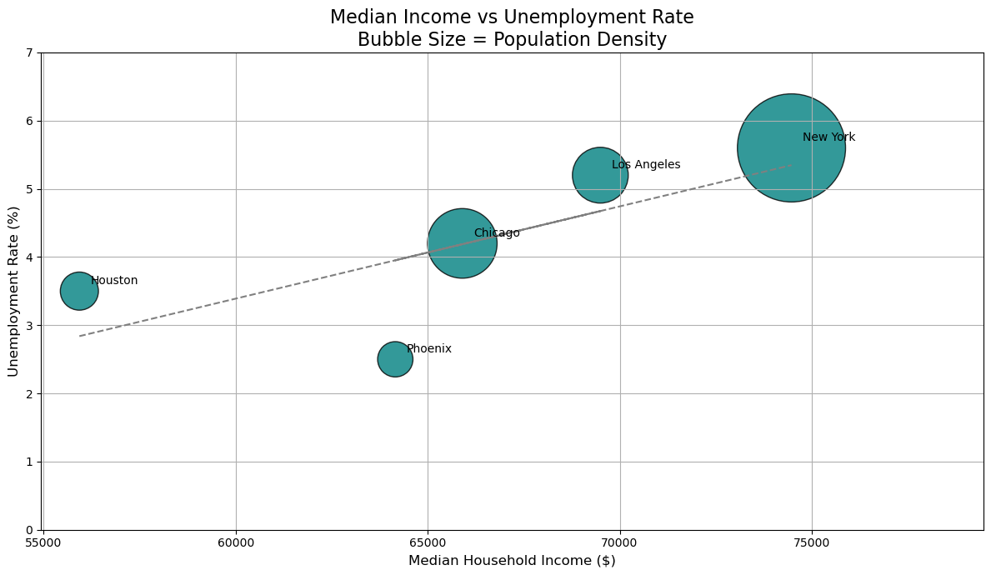
Visualization #2 – income/unemployment scatter plot

Slide 10
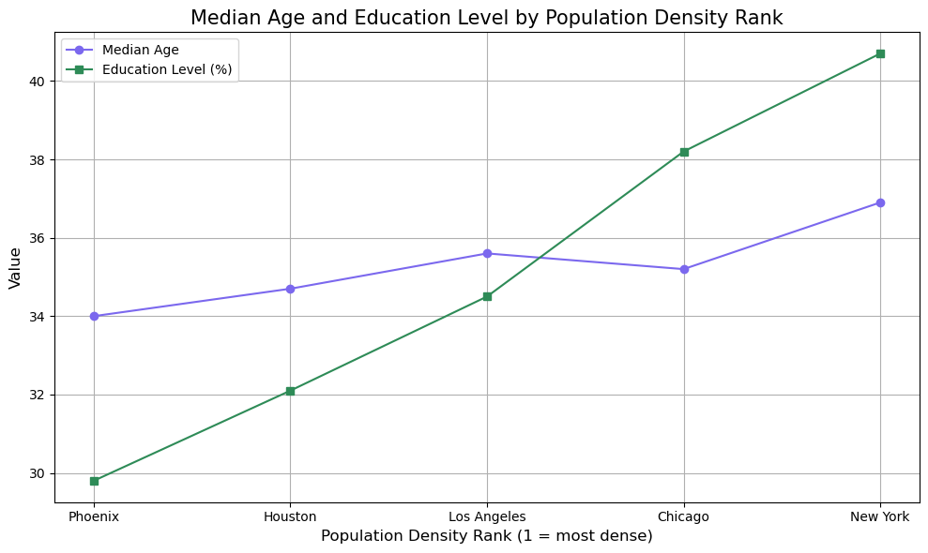
Visualization #3 – Age/Education double line graph

Slide 11
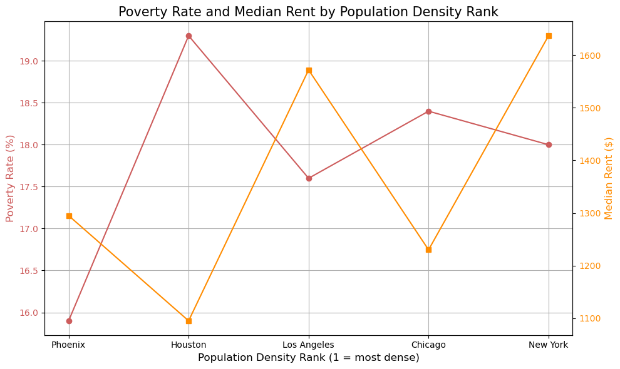
Visualization #4 – poverty/rent double line graph

Slide 12
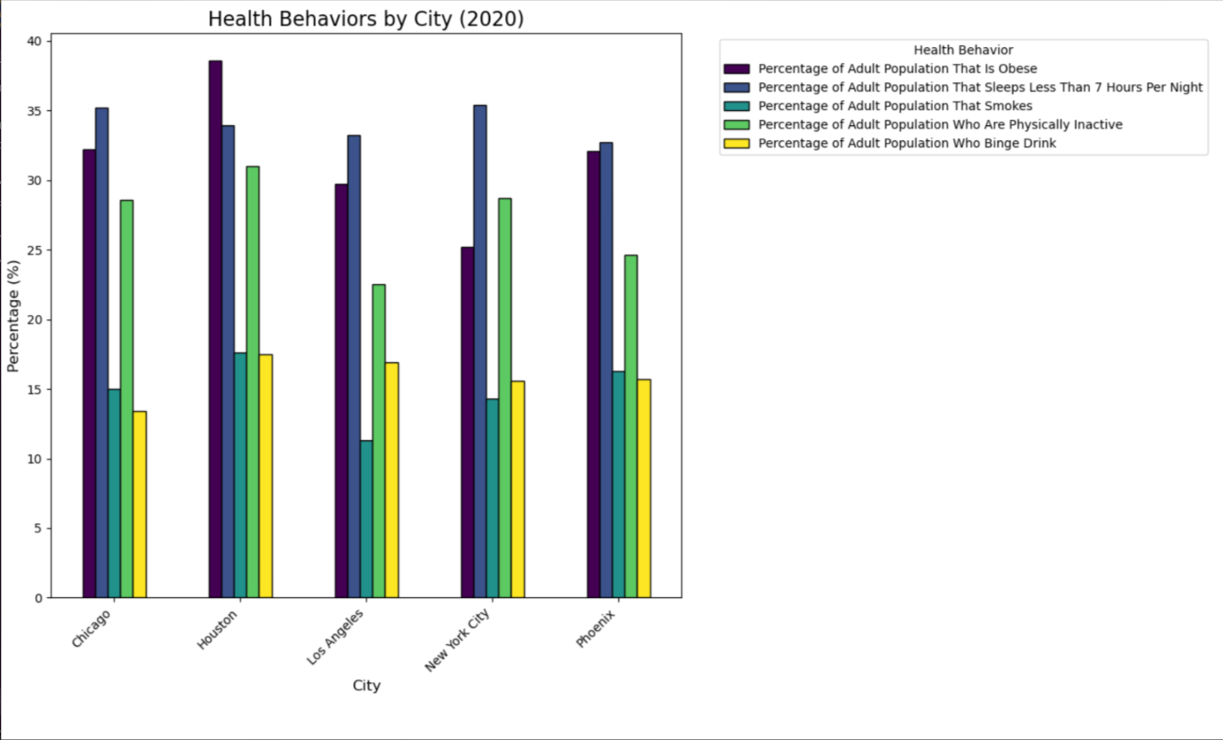
Visualization #5 Health Behavior Stacked Column Chart

Slide 13
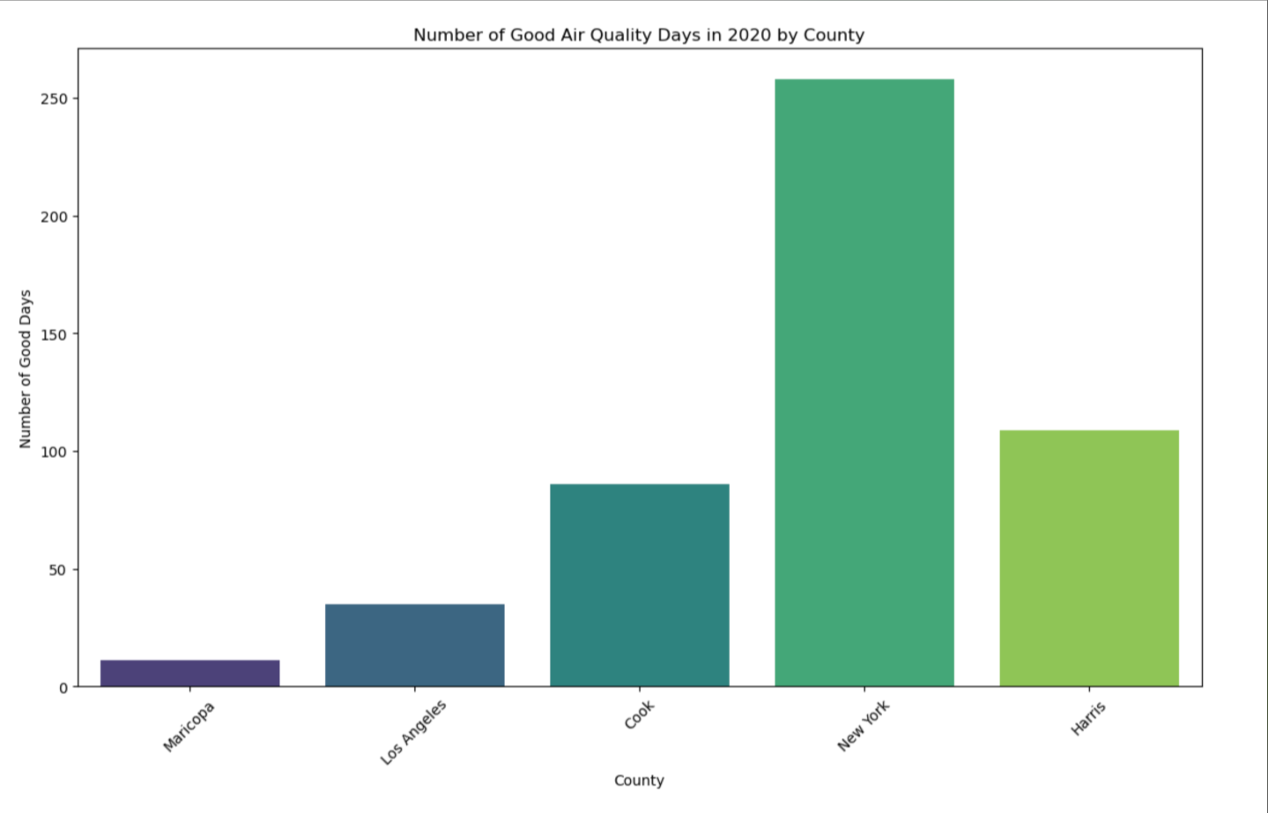
Visualization #6 – Good Air Quality Days Bar Chart

Slide 14
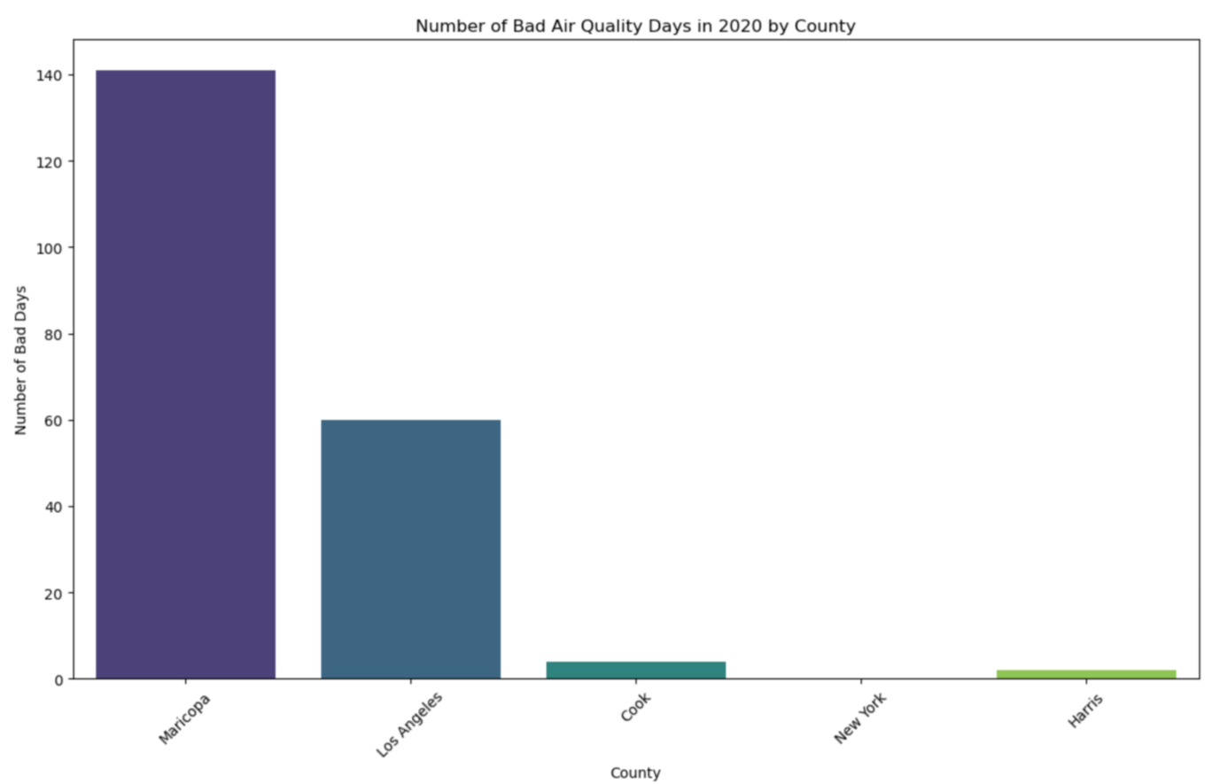
Visualization #7 – Bad air quality Days Bar Chart

Slide 15
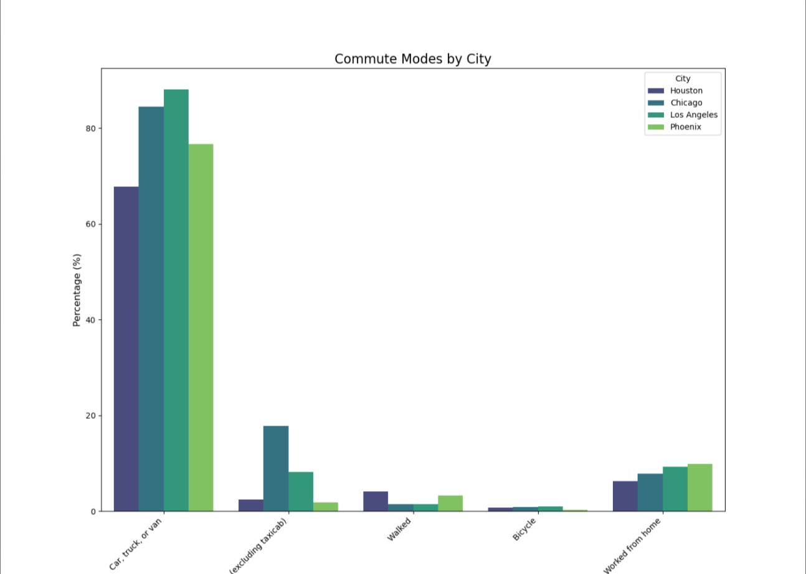
Visualization #8 Commute Modes by City

Slide 16
Conclusions
Each city has its own strengths and weaknesses. New York has high economic opportunities but significant income inequality and housing challenges.
Los Angeles, with its diverse and economically proven city, faces high unemployment and health behavior concerns.
Houston, with its rapid growth and diversity but growing health behavior concerns and "commutability".
Chicago with its economic challenges has a growing, highly education population.
Phoenix, with its emerging, growing urban hub, faces challenges with infrastructure.
By leveraging insights from demographic, economic, health, and racial metrics, policymakers and stakeholders can develop targeted strategies to improve quality of life and foster sustainable growth in urban areas, as they continue to develop.

